Slide 1
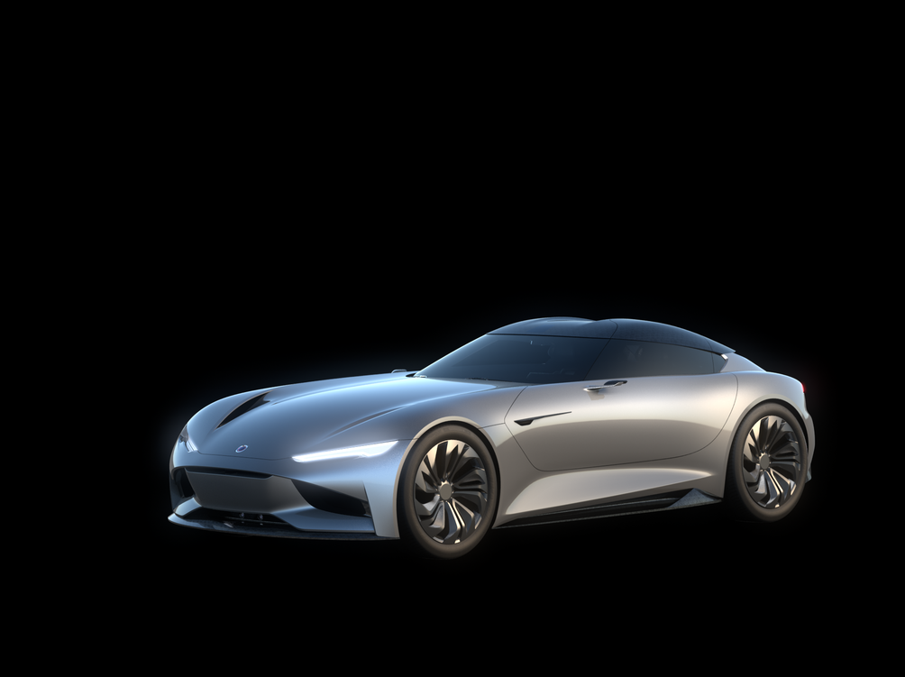
EE Systems integration & validation
EE Systems test report
SC2 Vision Door Control System

Slide 2
High Level Summary
Design door system control for the SC2 Vision concept car. This includes high level system schematic, back-end logic control, hardware and software design.

Slide 3
System Block Diagram
Linear Actuator
Driver Door
Jrk1 Motor Controller
Mobile APP
ESP32 (Arduino)
Exterior Lighting
Door Switches I/O
Jrk2 Motor Controller
Linear Actuator
Passenger Door
Hydraulic Pump

Slide 4
Electrical System Schematic

Slide 5
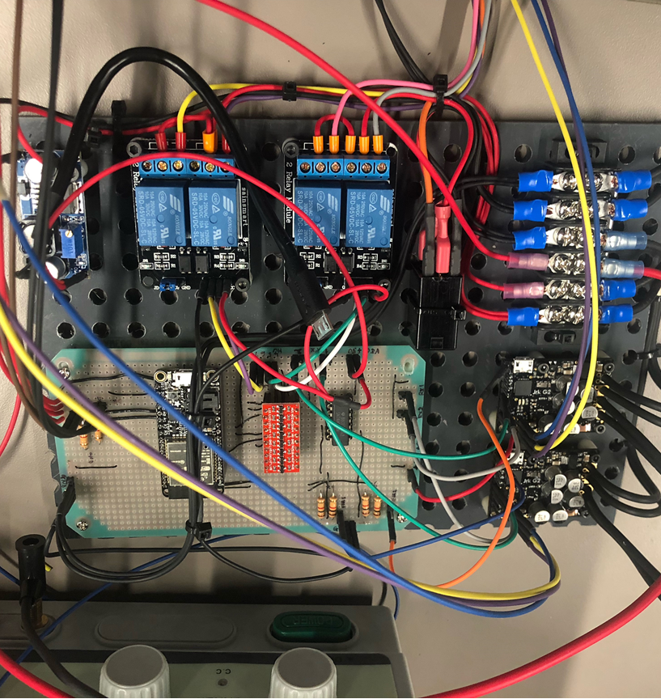
Electrical System

Slide 6
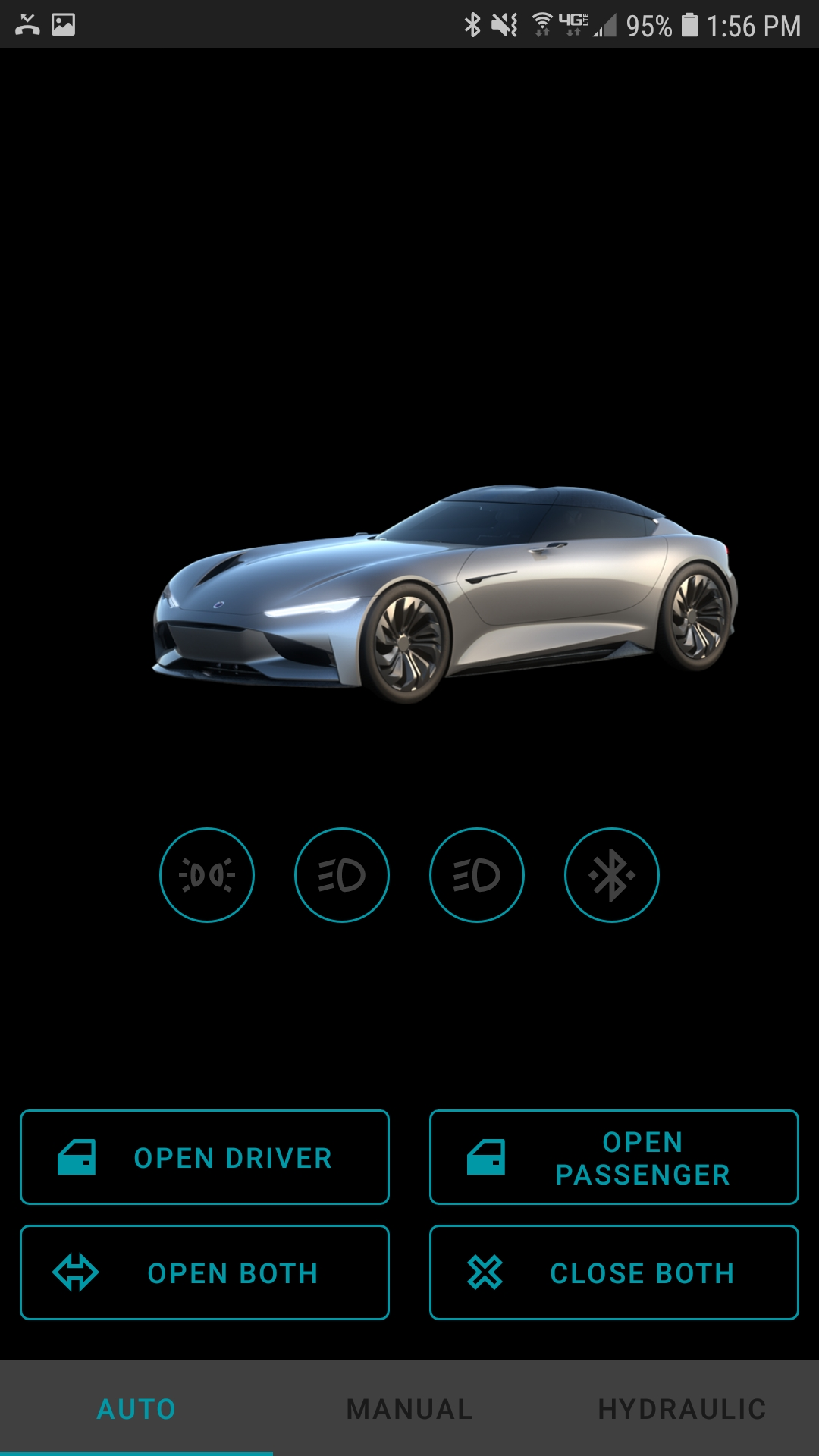
Mobile APP Control
Mobile APP function
Driver/Passenger momentary open | Momentary open for each individual driver door. Hold button to keep opening. Release button press to stop
Driver/Passenger momentary close | Momentary close for each individual driver door. Hold button to keep closing. Release button press to stop
Driver/Passenger automatic open | Automatically will open driver/passenger door or both doors simultaneously.
Driver/Passenger automatic close | Automatically will close driver/passenger door or both doors simultaneously.
Hydraulic pump control | Momentary control for vehicle hydraulic pump. Increase or decrease the suspension height.
Mobile APP feedback
Door status position | Mobile app animation will reflect door actual door status
System error | Mobile app will display if any system error occurs. It will display if driver/passenger system error or both
Obstacle detected | If motor detects excess current above normal load +- tolerance, it will read as obstacle/person in the way and doors will stop moving

Slide 7
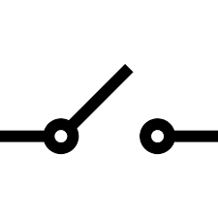
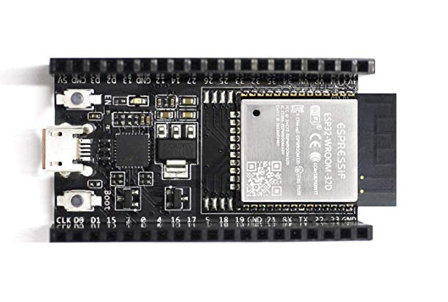
Door Switch Control
Driver/Passenger
Internal Switch
External Switch
Driver/Passenger switch function
Driver/Passenger Internal Switch | Automatic open or close for each door individually. Door will always automatically open all the way and will only close if previous position was full open.
Driver/Passenger External Switch | Automatic open or close for each door individually. Door will always automatically open all the way and will only close if previous position was full open.
Driver/Passenger Internal/External Switch | If switch is pressed while motor is moving, the switch will serve as a stop button.

Slide 8
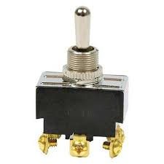
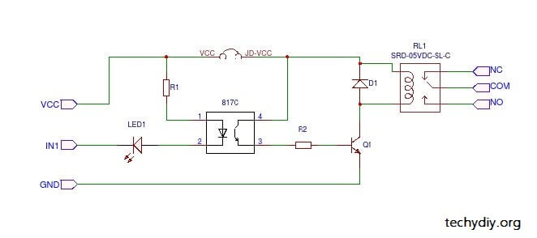
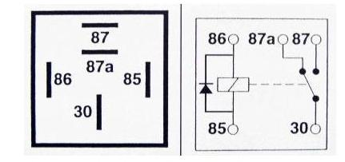
Hydraulic Pump Control
ESP32
3V->5V
Down
12V
Up

Slide 9
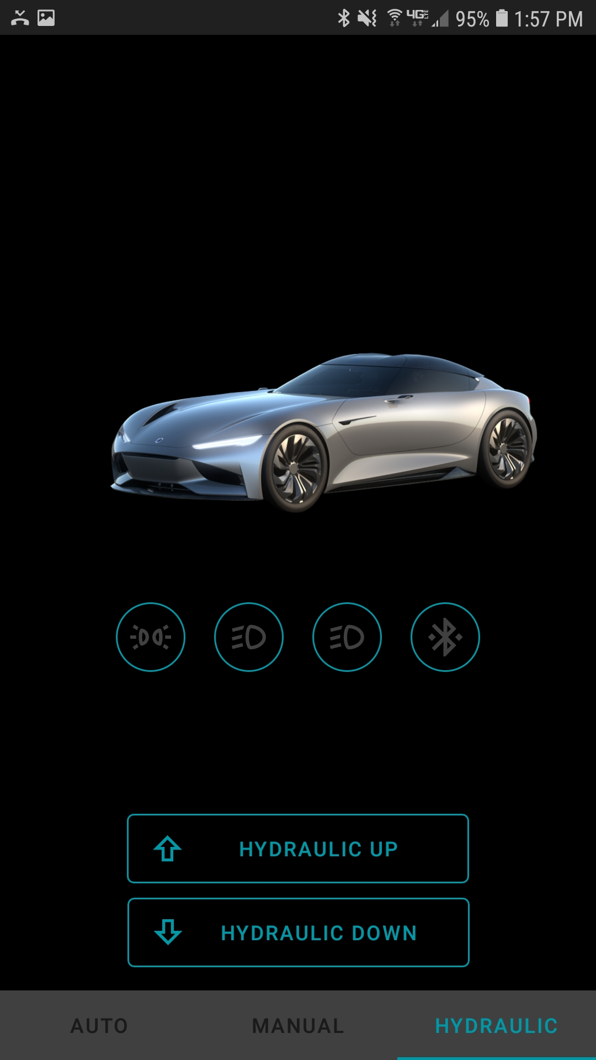
Hydraulic Pump Control Continued…
Hydraulic pump function
Momentary manual switch | Momentary “Up/Down” manual switch. This is a physical switch that will allow user to control hydraulic pump up and down. If the momentary switch is active, the 12V+ supply will be cut off from the “mobile app relay controls” to ensure no conflicting commands between physical switch and mobile app buttons.
Mobile App “UP” button | Mobile App will have a “Hydraulic Pump” control widget. The user can press the “Up” button to close relay and provide 12V+ to hydraulic pump. It is a momentary button, once button is released the relay will open and stop hydraulic pump.
Mobile App “DOWN” button | Mobile App will have a “Hydraulic Pump” control widget. The user can press the “Down” button to close relay and provide 12V- to hydraulic pump. It is a momentary button, once button is released the relay will open and stop hydraulic pump.

Slide 10
Light Control
Light control function
Mobile APP lights on button | Turn on the Front/Rear lighting using mobile app. Light status will reflect on mobile app.
Mobile APP lights off button | Turn off the Front/Rear lighting using mobile app. Light status will reflect on mobile app.
12V
ESP32
3V->5V
Front/Rear LED Lighting

Slide 11
The END

